Slide 1
Introduction: Using this presentation
Slides with the blue bar at the top give information and instruction relevant to the section of the training they are addressing.
Slides that are not formatted (only white with black writing) are for facilities to use to prepare training compliant with Minnesota Statutes 182.677, subdivision 4, Ergonomics – employee training.
All facilities must address all sections of the required training.

Slide 2


2026 Minnesota OSHA ergonomics employee training

Slide 3
Ergonomics – employee training Minnesota Statutes 182.677, subdivision 4
Minnesota OSHA Compliance | Department of Labor and Industry

Slide 4
Training requirements
An employer subject to this section must train all employees about the following:
the name of each individual on the employer’s safety committee;
the facility’s ergonomics program;
the early signs and symptoms of musculoskeletal injuries and the procedures for reporting them;
the procedures for reporting injuries and other hazards;
any administrative or engineering controls related to ergonomic hazards that are in place or will be implemented; and
the requirements of Minn. Stat. 182.677, subd. 9.

Slide 5
Minn. Stat. 182.676, Safety committees
Every public or private employer of more than 25 employees shall establish and administer a joint labor-management safety committee.
Every public or private employer of 25 or fewer employees shall establish and administer a safety committee if: it is subject to the requirements of Minn. Stat. 182.653, subd. 8.

Slide 6
Minn. Stat. 182.676, Safety committees, continued
A safety committee must hold regularly scheduled meetings unless otherwise provided in a collective bargaining agreement.
Employee safety committee members must be selected by employees. An employer that fails to establish or administer a safety committee as required by this section may be cited by the commissioner. A citation is punishable as a serious violation under Minn. Stat. 182.666.
See revisor.mn.gov/statutes/cite/182.676.

Slide 7
Warehouse distribution centers: Additional safety committee requirements
The employer must hold monthly meetings as provided under Minn. Stat. 182.676 until, for two consecutive years, the worksite or the employer does not have an employee incidence rate 30% higher than the average yearly incidence rate for the relevant North American Industry Classification System (NAICS) code.

Slide 8
Individual NAICS codes in the 30%-over category
See the MNOSHA Compliance: Warehouse workers webpage at dli.mn.gov/about-department/rulemaking/mnosha-compliance-warehouse-workers.

Slide 9
Health care facilities
Health care facilities must also pay attention to the committee requirements of the safe-patient-handling program statute in addition to the ergonomics statute.
Refer to Minn. Stat. 182.6553 for requirements at revisor.mn.gov/statutes/cite/182.6553.

Slide 10
Meat processing facilities: Additional committee requirements
There are additional requirements for meatpacking facility committees.
Refer to Minn. Stat. 179.876 for requirements at revisor.mn.gov/statutes/cite/179.876.

Slide 11
Safety committee members
[Name each individual on the safety committee.]
[List name and job title]

Slide 12
Safety committee members, meatpacking
[For meatpacking, add the following members.]
[A certified professional ergonomist (CPE)]
[A licensed, board-certified physician, with preference given to a physician who has specialized experience and training in occupational medicine]
[At least three workers employed in the employer’s facility who have completed a general industry outreach course approved by the commissioner, one of whom must be an authorized employee representative if the employer is party to a collective bargaining agreement]

Slide 13
Ergonomics program required
An ergonomics program is a systematic process for identifying, analyzing and controlling workplace risk factors, often for reducing musculoskeletal disorders.
The program shall include:​
an assessment to identify and reduce musculoskeletal disorder risk factors in the​ facility;​
an initial and ongoing training of employees on ergonomics and its benefits, including​ the importance of reporting early symptoms of musculoskeletal disorders;​
a procedure to ensure early reporting of musculoskeletal disorders to prevent or​ reduce the progression of symptoms, the development of serious injuries and lost-time​ claims;​

Slide 14
Ergonomics program required, continued
a process for employees to provide possible solutions that may be implemented to reduce, control or eliminate workplace musculoskeletal disorders;​
procedures to ensure physical plant modifications and major construction projects​ are consistent with program goals; and​
annual evaluations of the ergonomics program and whenever a change to the work​ process occurs.​

Slide 15
Ergonomics program resource
An ergonomics program is a systematic process for identifying, analyzing and controlling workplace risk factors, often for reducing musculoskeletal disorders.
The National Institute for Occupational Safety and Health (NIOSH) has created a site to assist in designing an effective ergonomics program to prevent work-related musculoskeletal disorders.
Visit cdc.gov/niosh/ergonomics/ergo-programs for more information.

Slide 16
[This facility’s] ergonomics program
[Detail each of the following about how the facility’s ergonomics program works.]
An assessment to identify and reduce musculoskeletal disorder risk factors in the​ facility
An initial and ongoing training of employees about ergonomics and its benefits, including​ the importance of reporting early symptoms of musculoskeletal disorders
A procedure to ensure early reporting of musculoskeletal disorders to prevent or​ reduce the progression of symptoms, the development of serious injuries and lost-time​ claims

Slide 17
[This facility’s] ergonomics program, continued
[Detail each of the following about how the facility’s ergonomics program works.]
A process for employees to provide possible solutions that may be implemented to​ reduce, control or eliminate workplace musculoskeletal disorders
Procedures to ensure physical plant modifications and major construction projects​ are consistent with program goals
Annual evaluations of the ergonomics program and whenever a change to the work​ process occurs
How to access the facility’s ergonomics program

Slide 18
Health care – NAICS codes
For health care facilities, safe patient-handling is a major risk factor for musculoskeletal injuries and illnesses.
Requirements for safe patient-handling are contained in Minn. Stat. 182.6553.
For more information, visit the MNOSHA WSC: Safe patient-handling webpage at dli.mn.gov/business/workplace-safety-and-health/mnosha-wsc-safe-patient-handling.

Slide 19
Reporting injuries and other hazards
Comprehensive injury reporting is important to the success of an ergonomics process. The goal of this effort is to properly assess, diagnose and treat musculoskeletal disorders. Early reporting, diagnosis and intervention can limit injury severity, improve the effectiveness of treatment, minimize the likelihood of disability or permanent damage and reduce workers’ compensation claims. This will allow the employer to correctly identify work areas or specific tasks where injuries frequently occur or are most severe.
This information helps direct the activities of the ergonomics team, as well as guide health care providers in making return-to-work and light-duty work decisions.
Federal OSHA’s injury and illness recording and reporting regulation (see osha.gov/laws-regs/regulations/standardnumber/1904) requires employers to record and report work-related fatalities, injuries and illnesses.

Slide 20
Early reporting of signs, symptoms of MSDs
Encouraging and using reports of musculoskeletal disorder (MSD) symptoms:
reinforces worker training about recognizing MSD symptoms;
encourages early reporting of MSD symptoms;
allows for prompt medical evaluations for diagnosis, treatment and follow-up care;
reduces injury severity, the number of workers’ compensation claims and associated costs, and the likelihood of permanent disability;
provides guidance about return-to-work and work-placement restrictions during the healing process;

Slide 21
Early reporting of signs, symptoms of MSDs, continued
guides job modifications;
provides a mechanism to track and trend MSD injuries; and
enables assessment of the effectiveness of work changes.

Slide 22
MDS signs, symptoms may include
Fatigue
Soreness
Aches and pain (aching or sharp)
Weakness
Discomfort
Tenderness
Burning
Tingling
Numbness
Stiffness
Swelling
Loss of coordination
Body parts “falling asleep”
Loss of strength
Loss of joint movement
Trouble sleeping due to pain

Slide 23
MSD signs, symptoms may include
Fatigue
Soreness
Aches and pain (aching or sharp)
Weakness
Discomfort
Tenderness
Burning
Tingling

Slide 24
MSD signs, symptoms may include, continued
Numbness
Stiffness
Swelling
Loss of coordination
Body parts “falling asleep”
Loss of strength
Loss of joint movement
Trouble sleeping due to pain

Slide 25
OSHA recordkeeping requirements
It is important to know there are requirements under 1904 for OSHA recordkeeping that you will need to consider when establishing or evaluating your procedures for reporting early signs and symptoms of musculoskeletal injuries.
Some injuries or illnesses reported to you may reach the level of needing to be on the OSHA 300 log; others may not reach that level. It is essential you understand what makes an injury or illness recordable.
OSHA recordkeeping also has an employee involvement aspect that must be addressed.

Slide 26
Basic requirement for OSHA recordkeeping
Your employees and their representatives must be involved in the recordkeeping system in several ways. You must:
inform each employee about how they are to report a work-related injury or illness to you;
provide employees with the information described in paragraph (b)(1)(iii) of this section; and
provide access to your injury and illness records for your employees and their representatives as described in paragraph (b)(2) of this section.
See 1904.35(a) through 1904.35(a)(3) at osha.gov/laws-regs/regulations/standardnumber/1904/1904.35.

Slide 27
OSHA recordkeeping – employee reporting of injuries, illnesses
What must I do to ensure employees report work-related injuries and illnesses to me?
You must establish a reasonable procedure for employees to report work-related injuries and illnesses promptly and accurately. A procedure is not reasonable if it would deter or discourage a reasonable employee from accurately reporting a workplace injury or illness.
You must inform each employee of your procedure for reporting work-related injuries and illnesses.

Slide 28
OSHA recordkeeping – employee reporting of injuries, illnesses, continued
You must inform each employee:
they have the right to report work-related injuries and illnesses; and
employers are prohibited from discharging or discriminating against any employee for reporting work-related injuries or illnesses.
You must not discharge or in any manner discriminate against any employee for reporting a work-related injury or illness.

Slide 29
Incentive programs
Incentive programs may discourage reporting. Incentive programs are not banned by OSHA, but must be developed to not interfere with or discourage employee reporting. Guidance for development of incentive programs is included in the following standard interpretations:
Clarification of OSHA’s Position on Workplace Safety Incentive Programs and Post-Incident Drug Testing Under 29 C.F.R. §1904.35(b)(1)(iv) at osha.gov/laws-regs/standardinterpretations/2018-10-11; and
Employer Safety Incentive and Disincentive Policies and Practices at osha.gov/laws-regs/standardinterpretations/2012-03-12-0.

Slide 30
Procedures for reporting early signs, symptoms MSDs
[What should be reported?]
[When should a hazard be reported?]
[How should workers make reports?]
[How will management respond to reports?]
[What should workers expect after making a report?]
[How will you make sure all workers understand the reporting process?]
[How will you make it clear no worker will face retaliation for reporting?]
[How might you recognize workers who identify and report hazards?]

Slide 31
Reporting other hazards, 1 of 3
What should be reported? Your system should encourage reporting of all types of safety and health concerns (injuries, illnesses, anticipated hazards from new processes or equipment, unsafe conditions or behaviors, close calls and near misses, hazards from non-routine tasks and potential emergencies, and weaknesses of your safety and health program).
When should a hazard be reported? Your system should empower workers to report hazards immediately. Workers should also know they can stop any operation they believe to be unsafe.
How should workers make reports? Think of options for workers to report to management verbally or in writing. If possible, give workers a way to report anonymously.

Slide 32
Reporting other hazards, 2 of 3
How will management respond to reports? Make sure your system directs management to promptly acknowledge reports and begin an investigation.
What should workers expect after making a report? Your process should involve regular communication about actions taken to address reported hazards.
How will you make sure all workers understand the reporting process? Consider barriers, such as language, literacy and internet access.
How will you make it clear no worker will face retaliation for reporting? Make sure workers know you will only use reports to improve safety and health.
How might you recognize workers who identify and report hazards? Consider a bonus, a gift certificate or a public thank you.

Slide 33
Reporting other hazards, 3 of 3
How will you involve workers in finding solution to reported concerns? Your system should encourage workers to suggest ways to eliminate or control the hazard. This could be at the time of the report, after the report or both. This part of your system will be important when you begin work on hazard prevention and control.

Slide 34
Reporting other hazards – workplace hazards
A workplace hazard is any condition, activity or source that could, if left uncontrolled, lead to an injury or illness. Examples include:
safety hazards – slippery floors, broken ladder rungs, hot surfaces, machinery with moving parts, electrical hazards and confined spaces;
health hazards – chemicals, viruses, heat and noise; and
other hazards – stress, workplace violence, activities that cause wear and tear on the body, and assigning an untrained worker to a hazardous job.

Slide 35
Procedures for reporting other hazards
[What should be reported?]
[When should a hazard be reported?]
[How should workers make reports?]
[How will management respond to reports?]
[What should workers expect after making a report?]
[How will you make sure all workers understand the reporting process?]
[How will you make it clear no worker will face retaliation for reporting?]
[How might you recognize workers who identify and report hazards?]

Slide 36
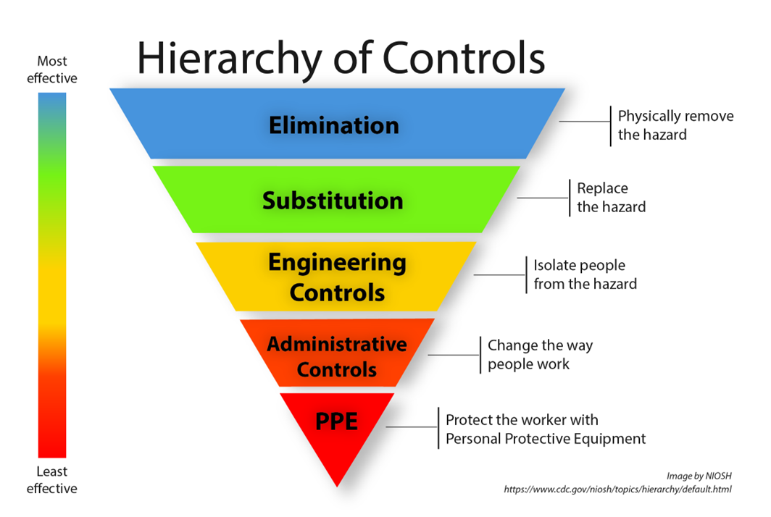
Hierarchy of controls

Slide 37
Engineering controls
To reduce the chance of injury, work tasks should be designed to limit exposure to ergonomic risk factors. Engineering controls implement physical changes to the workplace, which eliminates or reduces the hazard on the job or task and are the most desirable, where possible. Engineering controls include:
automation;
mechanization;
lifting equipment;
using a device to lift and reposition heavy objects to limit force exertion;
reducing the weight of a load to limit force exertion;

Slide 38
Engineering controls, continued
repositioning a worktable to eliminate a long or excessive reach and enable working in neutral postures;
using diverging conveyors off a main line so tasks are less repetitive;
installing diverters on conveyors to direct materials toward the worker to eliminate excessive leaning or reaching; and
redesigning tools to enable neutral postures.

Slide 39
Engineering controls for ergonomic hazards, in place or to be implemented
[Detail engineering controls for ergonomic hazards that are in place.]
[Detail engineering controls for ergonomic hazards that will be implemented.]

Slide 40
Administrative controls
Administrative controls establish work practices that reduce the duration, frequency or intensity of exposure to hazards. This may include:
work process training;
job rotation;
job expansion;
ensuring adequate rest breaks;
adjusting line speeds;
establishing a lifting limit;
adjusting production rates;
increasing staffing;
maintaining tools;
reducing shift length or limiting the amount of overtime;
changing job rules and procedures, such as scheduling more breaks to allow for rest and recovery;

Slide 41
Administrative controls, continued
training in the recognition of risk factors for MSDs and instructions in work practices and techniques that can ease the task demands or burden, such as stress and strain;
rotating workers through jobs that are physically tiring;
requiring heavy loads only be lifted by two people, to limit force exertion;
establishing systems to rotate workers away from tasks to minimize the duration of continual exertion, repetitive motions and awkward postures;
staffing “floaters” to provide periodic breaks between scheduled breaks; and
properly using and maintaining pneumatic and power tools.

Slide 42
Administrative controls for ergonomic hazards, in place or to be implemented
[Detail administrative controls for ergonomic hazards that are currently in place.]
[Detail administrative controls for ergonomic hazards that will be implemented.]

Slide 43
Minn. Stat. 182,677, subd. 9, Reporting encouraged
“Any employer subject to this section must not institute or maintain any program, policy, or practice that discourages employees from reporting injuries, hazards, or safety and health standard violations, including ergonomic-related hazards and symptoms of musculoskeletal disorders.”

Slide 44
Programs, policies, practices that may affect reporting
Recommended practices for anti-retaliation programs, at osha.gov/sites/default/files/publications/OSHA3905.pdf, provides recommendations and guidelines for preventing and addressing worker retaliation. – OSHA directorate of whistleblower protection programs, 2017.
OSHA memorandum on employer safety incentive and disincentive policies and practices, at osha.gov/laws-regs/standardinterpretations/2012-03-12-0, describes types of safety incentive policies that might discourage reporting.

Slide 45
Programs, policies, practices that may affect reporting, continued
Clarification of OSHA's Position on Workplace Safety Incentive Programs and Post-Incident Drug Testing, at whistleblowers.gov/memo/2018-10-11.
Examples of Rate-based Incentive Programs Submitted to OSHA, at osha.gov/sites/default/files/ExamplesofRate-BasedIncentiveProgramsSubmittedtoOSHARegulatoryDocket.pdf.

Slide 46
Reporting encouraged
[Detail how reporting is encouraged at the facility.]

Slide 47
Training frequency
New employees must be trained according to paragraph (a) prior to starting work.
Current employees must receive initial training and ongoing annual training in accordance with the employer’s ergonomics program.
The employer must provide training during the working hours and compensate the employee for attending the training at the employer’s standard rate of pay. All training must be in a language and with vocabulary the employee can understand.

Slide 48
Resource links
OSHA ergonomics – osha.gov/ergonomics
NIOSH ergonomics – cdc.gov/niosh/ergonomics
California ergonomic hazards factsheet – dir.ca.gov/chswc/woshtep/iipp/materials/SB_Factsheet_H_ErgonomicHazards.pdf
Colorado State University musculoskeletal disorders, risk factors and reporting – rmi.colostate.edu/ergonomics/injuries-and-injury-prevention/musculoskeletal-disorders-risk-factors-reporting

Slide 49
MNOSHA Workplace Safety Consultation
Minnesota OSHA (MNOSHA) Workplace Safety Consultation works with employers and employees to solve safety and health problems before they occur. It offers free on-site consultation services, upon request, for employers that want to learn how to improve safety and health at their worksite.
For more information, visit the Minnesota OSHA Workplace Safety Consultation webpage at dli.mn.gov/about-department/our-areas-service/minnesota-osha-workplace-safety-consultation. Contact MNOSHA Workplace Safety Consultation at osha.consultation@state.mn.us, 651-284-5060 or 800-657-3776.

Slide 50
Disclaimer
This material can be provided in a different format (audio, Braille or large print) by calling the MNOSHA Training/Outreach Office at 651-284-5050 or 877-470-6742.
Material contained in this publication is in the public domain and may be reproduced, fully or partially, without permission of the Minnesota Department of Labor and Industry or MNOSHA. Source credit is requested but not required.
For more information, contact MNOSHA Compliance:
by mail at Minnesota Department of Labor and Industry, Occupational Safety and Health Division, 443 Lafayette Road N., St. Paul, MN 55155;
by email at osha.compliance@state.mn.us; or
online at dli.mn.gov/safety-and-health-work.

Slide 51
Thank you
Minnesota OSHA Compliance osha.compliance@state.mn.us 651-284-5050 or 877-470-6742

