Slide 1

2026 Minnesota Workers’ Compensation System Report: Trends and highlights
Hared Mah, research scientist
DLI Research and Data Analytics
10/14/2026

Slide 2
Topics
Workers’ Compensation System Report 2026
  System overview
  Indemnity benefits
  Vocational rehabilitation
  Dispute resolution
Notes:
Topics-briefly
This presentation focuses mainly on the 2026 Workers’ Compensation System Report, which provides trend data beginning with 2004 on key aspects of Minnesota’s workers’ compensation system, including claims, benefits and costs, vocational rehabilitation, and dispute resolution. Minnesota’s work comp system continues to evolve. There are internal system changes related to benefit levels and medical fee schedules, changes to the PPD schedule, and changes to how PTSD claims are compensated. At the same time, broader economic and labor-force shifts continue to influence the overall environment for the work comp system.

Slide 3
Workers’ Compensation System Report features
Primary data sources (among others)
  Department of Labor and Industry (DLI) claims database — limited to claims with lost time or paid indemnity benefits. This includes updates to benefits undercounted in approximately 9% of claims in recent years due to Campus system logic.
  Minnesota Workers’ Compensation Insurers Association (MWCIA) — Minnesota’s Workers’ compensation data service organization and rating bureau
Adjustment of cost data for average wage growth
  “Inflation adjustment”
  Adjusted costs show how much costs have grown faster or slower than wages.
  If actual cost of benefits grows at same rate as wages, the net effect is no change in cost relative to payroll.
  Cost amounts in this report were adjusted for growth in the statewide average weekly wage (SAWW) between the respective injury-year and 2024.

Slide 4
Workers’ Compensation System Report features, continued
“Developed statistics”
  Many report statistics are by year of injury.
  To make statistics comparable over time, they are projected (“developed”) to a uniform maturity. More-recent injury years are less mature because of long claim life.
  Developed statistics for recent years are subject to change.
  2020-2022 statistics were affected by the COVID-19 pandemic, changes in the economy and data system transition. COVID-19 claims were not developed.
  Vocational rehabilitation plan closure years start in October and end in September of the year number.
    This keeps years consistent with qualified rehabilitation consultant (QRC) hourly rate changes and many other aspects of workers' compensation statutes and allows full use of the available data.
Notes:
(Computing developed statistics for COVID-19 claims is nearly impossible, as these claims are unlikely to follow the pattern of claims from previous years.)

Slide 5
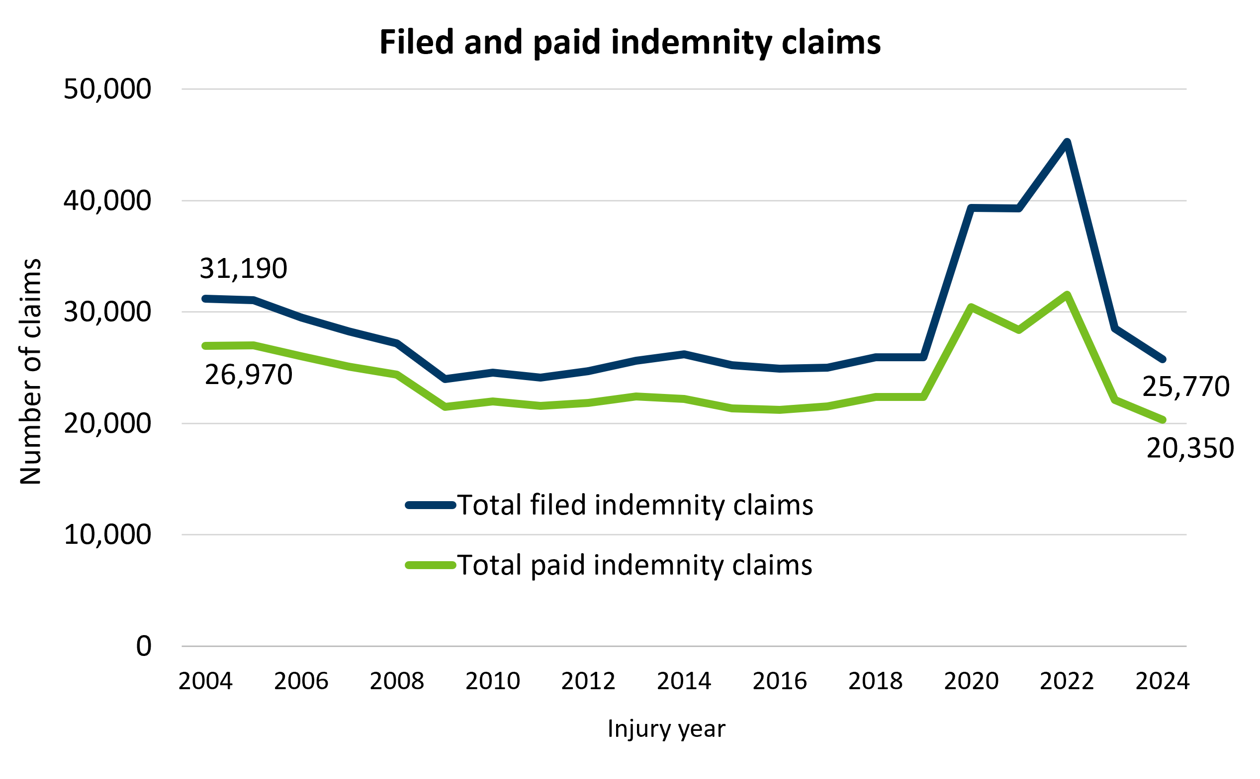
Claim trends returned to pre-pandemic levels after COVID-19 spike in 2020-2022
After pandemic-related increases in 2020-2022, filed and paid indemnity claims returned to their pre-pandemic levels in 2023-2024.
In 2024, the denial rate for non-COVID-19 filed claims was 17% – similar to 2023.
Filed and paid COVID-19 claims, 2020-2024
Injury year | Filed Covid-19 claims | Paid Covid-19 claims
2020 | 16,840 | 11,610
2021 | 12,040 | 7,070
2022 | 18,120 | 10,170
2023 | 2,170 | 1,030
2024 | 580 | 340
Source: Developed statistics from DLI Work Comp Campus database.
Notes:
Indemnity claim trends spiked between 2020 and 2022 due to COVID‑19, but by 2024, both filed and paid claims returned to their pre‑pandemic trends, as the number of COVID-19 claims declined. The denial rate for non‑COVID claims also remained stable at around 17%, similar to 2023.
Filed indemnity claims include all cases in which the worker missed more than three calendar days of work due to injury, even if the request for indemnity benefits was ultimately denied. Paid indemnity claims include any claim in which the injured worker received any type of benefit payment, including claims paid through settlement after an initial denial.

Slide 6
The big picture: Workers’ compensation system overview
Notes:
This section will present a broad overview of trends in claims, benefits and costs in the Minnesota workers’ compensation system.

Slide 7
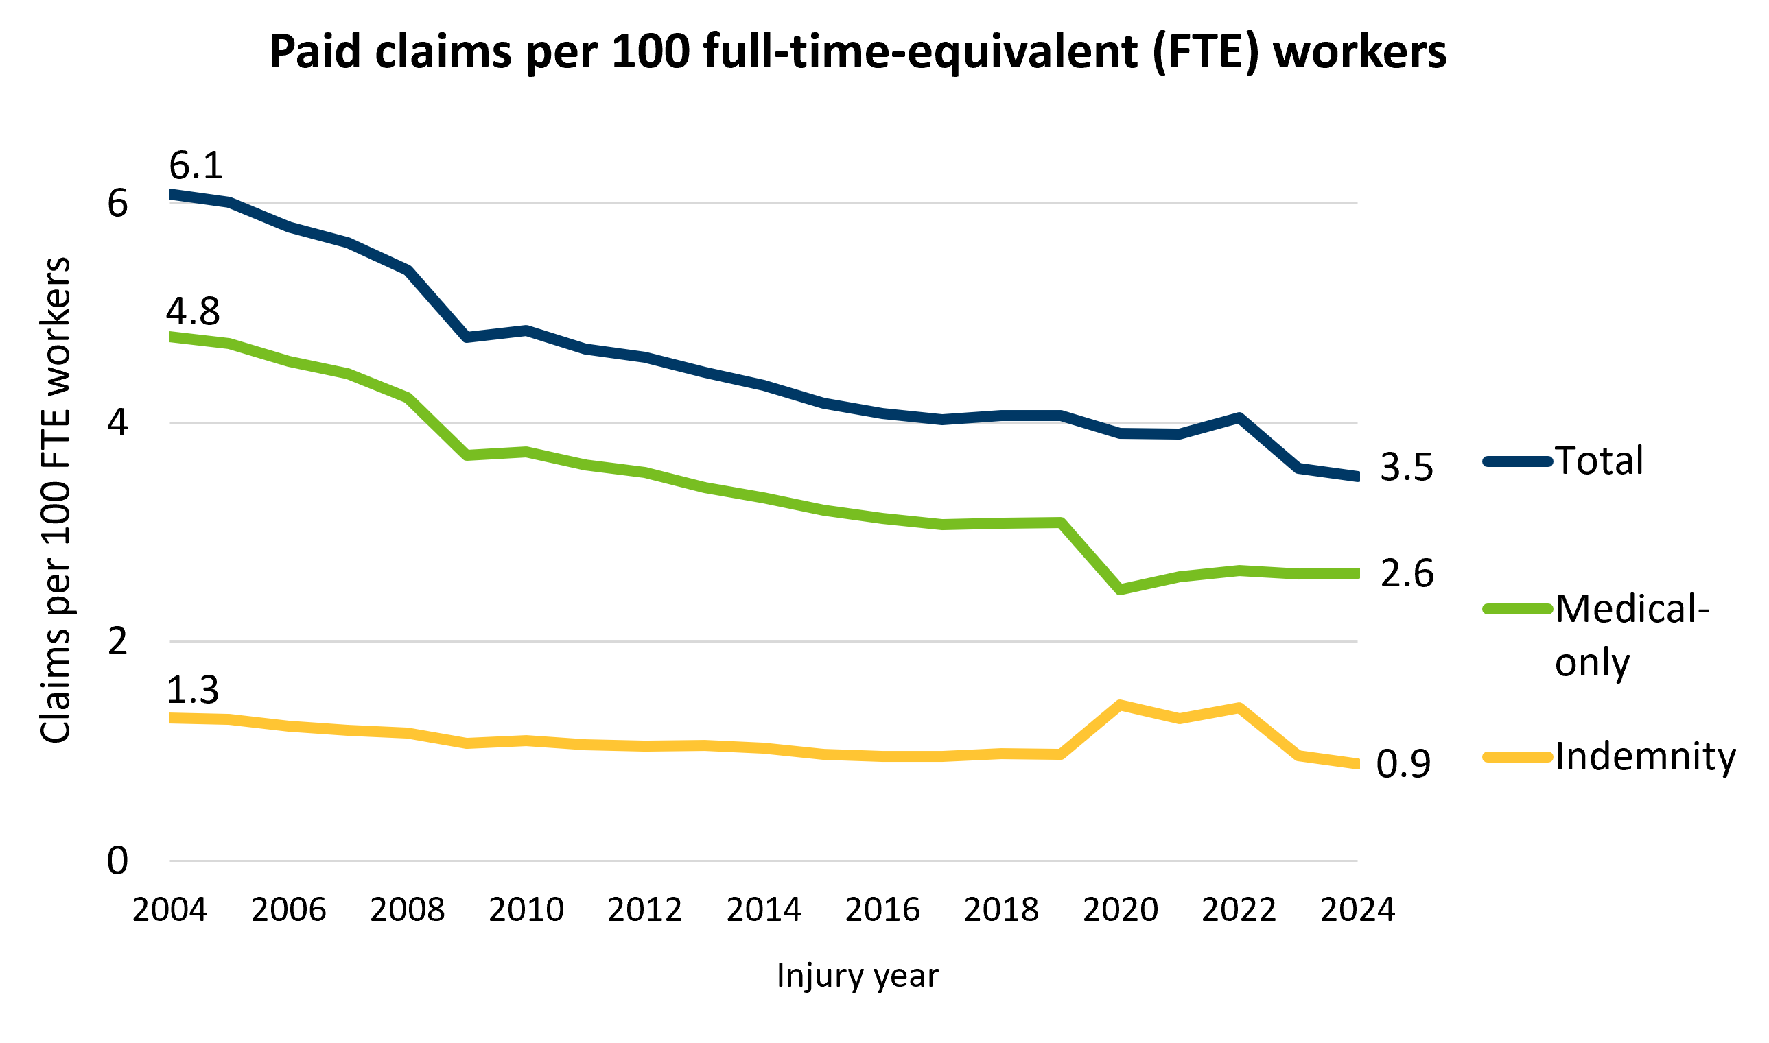
Claim rates continued long-term decline, with fluctuations during pandemic
Long-term trend:
From 2004 to 2024, claim rates declined substantially:
  indemnity claim rate declined 32%;
  medical-only claim rate declined 45%;
  total claim rate declined 42%, reaching its lowest level in 2024.
Pandemic impact (2020-2022):
Claim rates fluctuated during the pandemic period.
Most COVID-19 claims were indemnity claims.
Source: Developed statistics from DLI and MWCIA data.
Notes:
A starting point for understanding trends in the Minnesota workers’ compensation system is the claim rate — the number of paid claims per 100 full-time-equivalent (FTE) workers. Indemnity claims are claims with monetary benefits that compensate the injured or ill worker for wage loss or permanent functional impairment; these claims typically have medical benefits also. The remainder of claims are called medical-only claims because they only have medical benefits that consist of necessary medical services related to the injury or illness.
Over the past twenty years, we’ve seen a steady decline in claim rates across all types—indemnity, medical‑only, and total claims. By 2024, total claim rate was down by 42% from 2004, reaching its lowest point on record. The COVID-19 pandemic created some temporary fluctuations in 2020 through 2022, mainly due to the influx of COVID‑19 claims, which were largely indemnity claims, as well as shifts in the workforce and healthcare utilization. But even with that disruption, the long‑term trend shows a consistent reduction in claim frequency. Downward trend in the total claim rate has been similar to Minnesota’s total reportable case rate from the BLS Survey of Occupational Injuries and Illnesses.
In 2024, there were an estimated 80,700 total paid claims in 2024.
Of the 20,300 paid indemnity claims in 2024, approximately 340 were COVID-19 claims.
Indemnity claims typically make up about 25% of all paid claims, with the remainder constituting medical-only claims. These percentages have fluctuated during the pandemic.

Slide 8
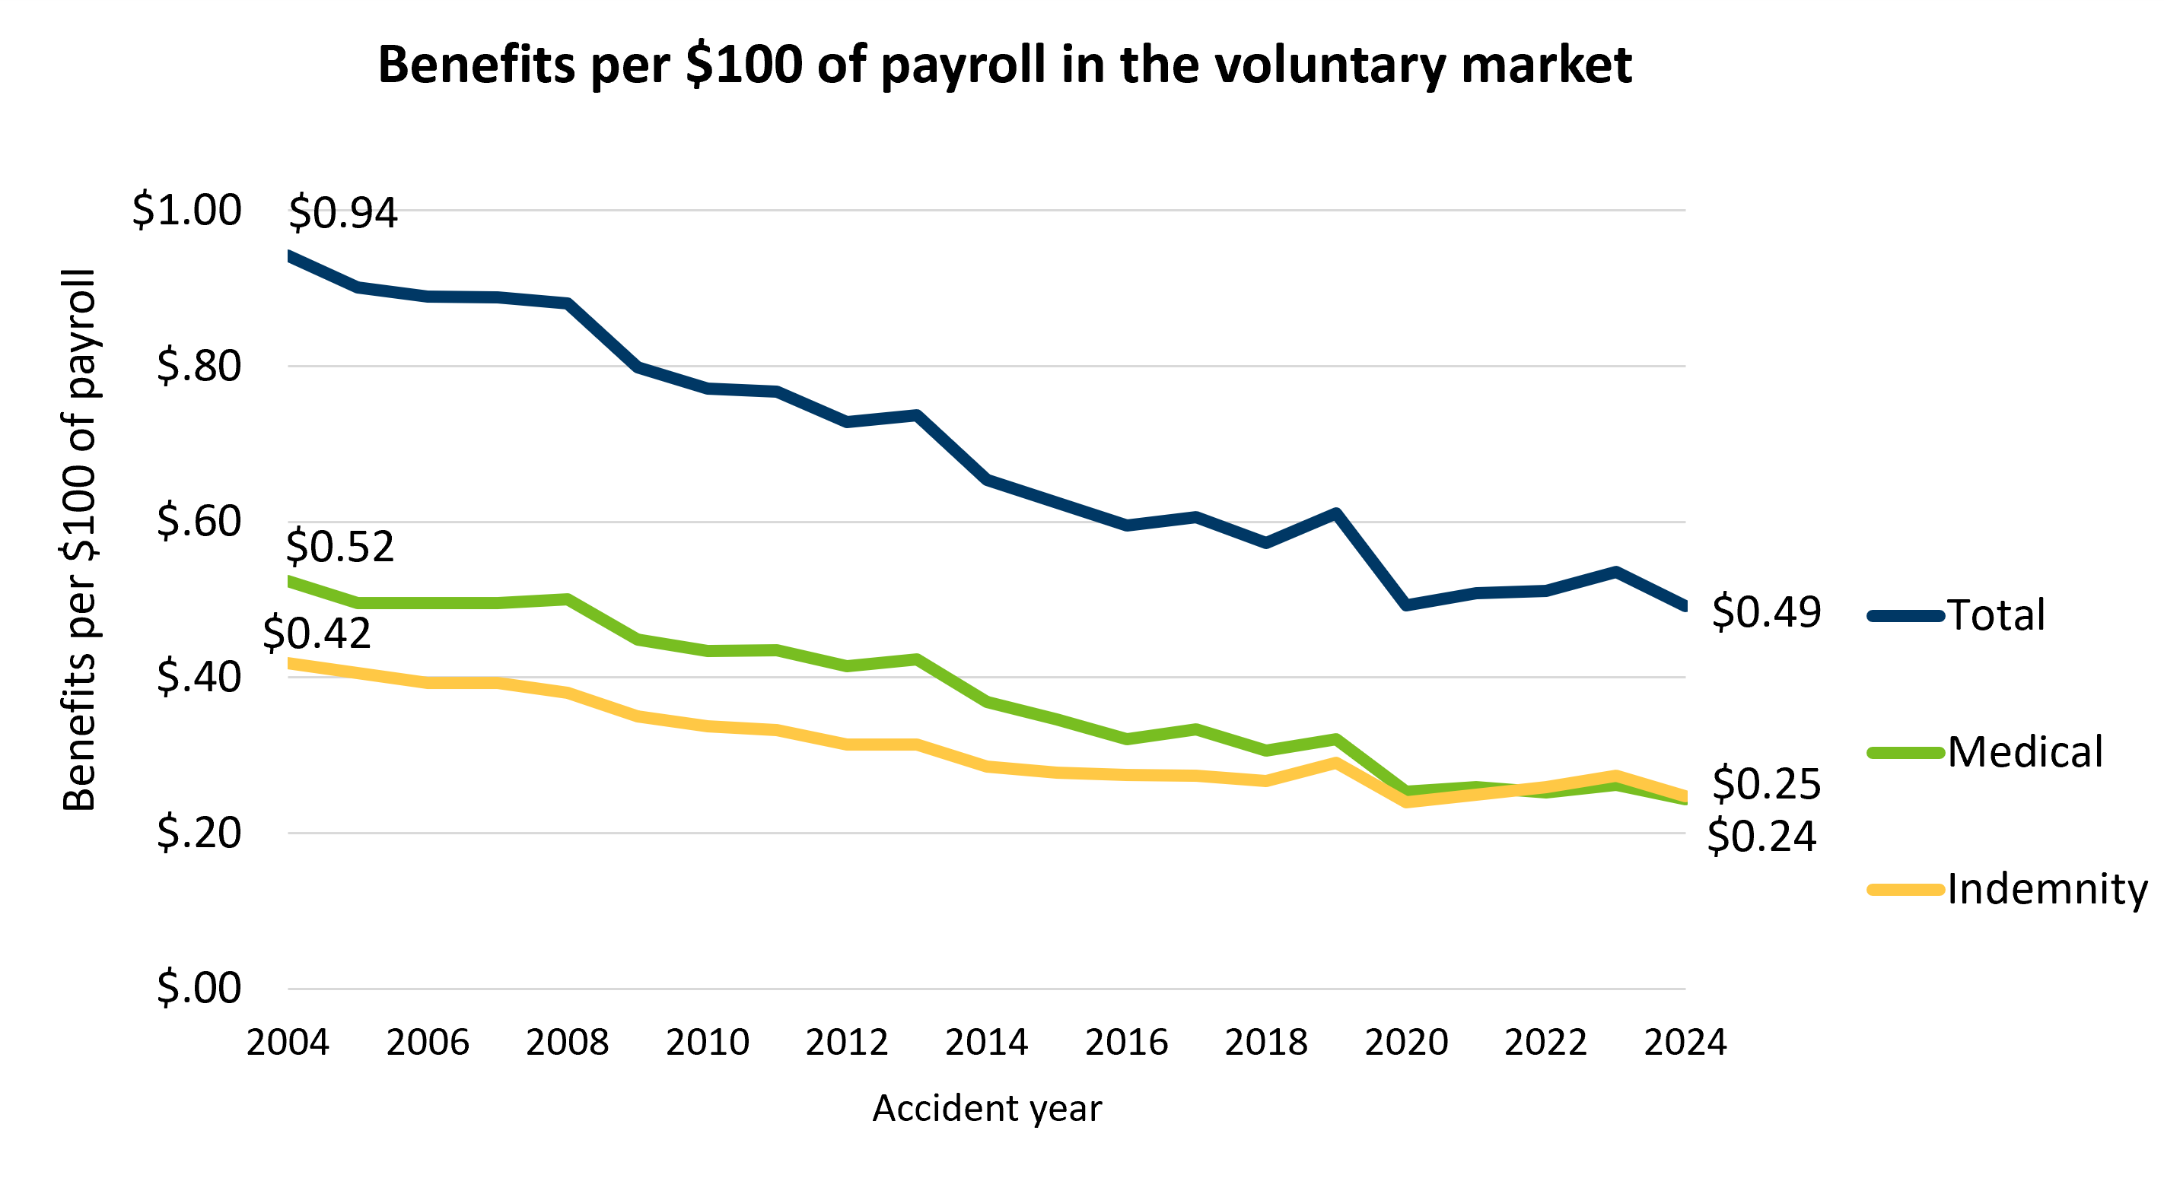
Benefits per $100 of payroll declined substantially over last 20 years
From 2004 to 2024, relative to payroll:
  indemnity benefits were 41% lower;
  medical benefits were 53% lower;
  total benefits were 48% lower.
Source: Developed statistics from MWCIA data. Excludes self-insured employers and the Assigned Risk Plan.
Notes:
Looking at benefits relative to payroll in the voluntary market, we see a steady decline over the last 20 years. In 2004, total benefits per $100 of payroll were about 94 cents. By 2024, that amount dropped to about 49 cents, a reduction of 48%. Both indemnity and medical benefits followed similar downward trends, falling by 41% and 53, respectively. So even as payrolls have grown, benefit costs have become much smaller relative to those payroll levels. Long-term decline in benefits per $100 of payroll also affects premium rates and workers’ compensation system cost relative to payroll, which are discussed in the next slides.
Indemnity and medical benefit percentages in the voluntary market:
In 2024, the indemnity share of total benefits was around 50% and increased from 44% in 2004. Medical benefits share was also around 50% and decreased from 56% of total benefits in 2004.

Slide 9
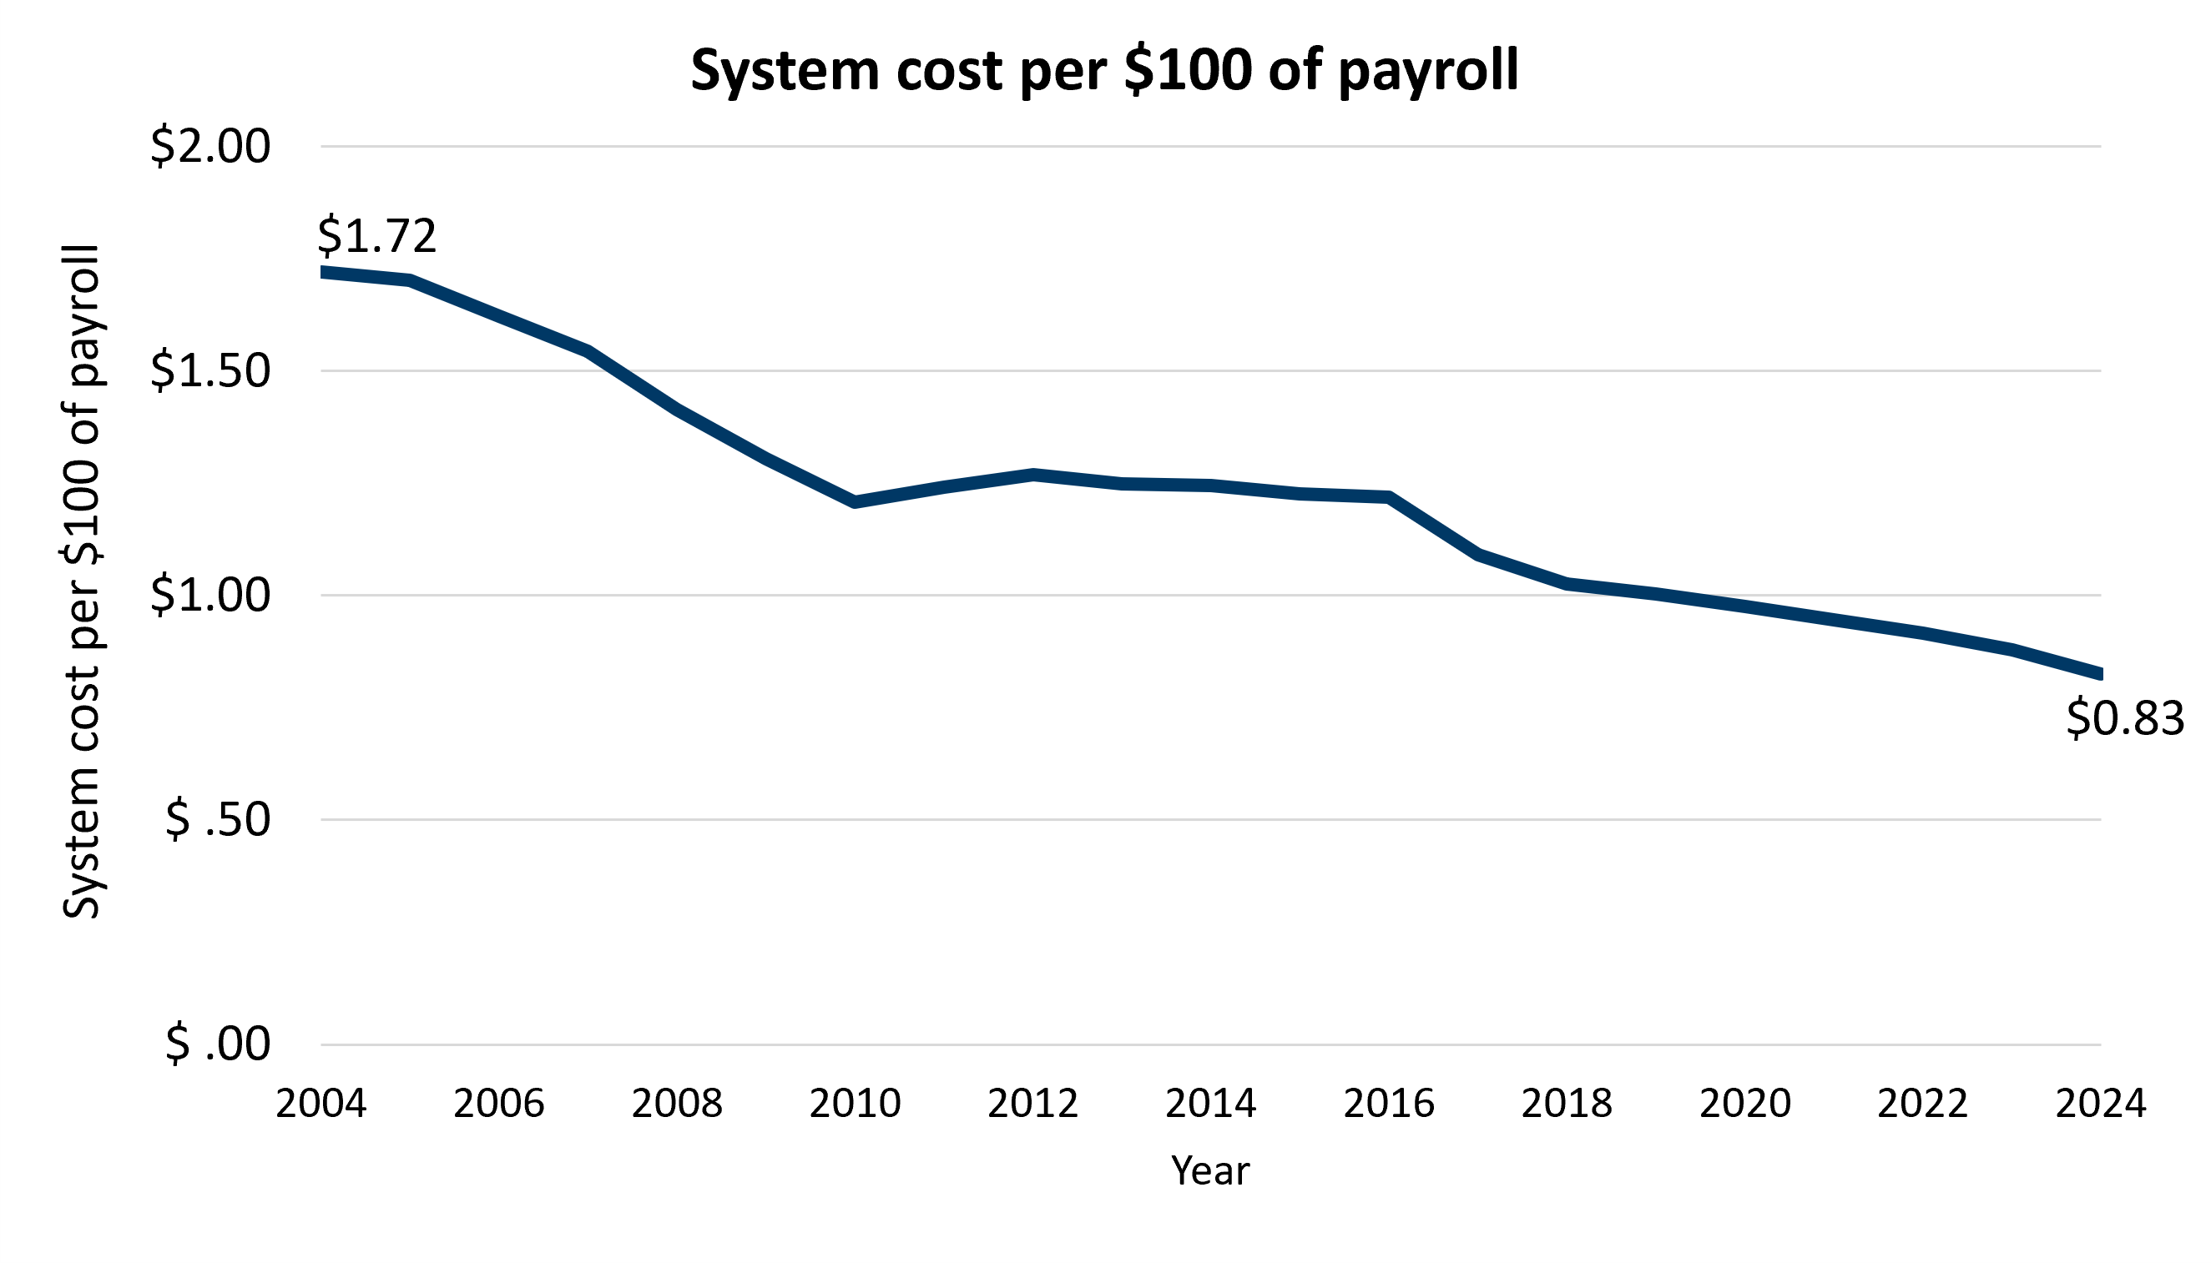
System cost relative to payroll continued long-term decline
In 2024, total system cost was an estimated $1.70 billion, or $0.83 per $100 of payroll.
System cost includes benefit costs, insurer expenses and administrative costs.
Long-term downward trend in system cost relative to payroll continued amid annual fluctuations:
  46% decrease over 20 years
Source: Estimated with data from the MWCIA, WCRA, DOC, DEED, and DLI. Includes insured and self-insured employers. Computed primarily from insurance premiums and self-insurer costs.
Notes:
System cost relative to payroll continued its long‑term downward trend in 2024. Back in 2004, system costs were about $1.72 per $100 of payroll. By 2024, that figure dropped to $0.83. Estimated total cost was around $1.70 billion in 2024.
The cost of Minnesota’s workers’ compensation system per $100 of payroll follows a cycle of about 10 years, partly reflecting a nationwide insurance pricing cycle, with alternating low and high points. Overall, there was a 27% reduction in system cost per $100 of payroll from 2004 to 2024 when comparing two comparable ten‑year periods. Extrapolated to 20 years, this would be a 46% decrease.
Background:
WC system cost per $100 of payroll includes components for insured and self-insured employers. (Self-insurers are about 25% of the market.)
The insured component primarily reflects premiums charged to employers.
The self-insured component primarily reflects estimates of claim costs and administrative costs.
Since system cost is primarily based on insurance premiums, it reflects claim costs PLUS insurance brokerage, underwriting, claim adjustment, litigation, taxes and assessments, and insurer profits.
The trend in system cost per $100 of payroll reflects claim cost trends plus fluctuations in insurer pricing behavior (ratio of premiums to costs)

Slide 10
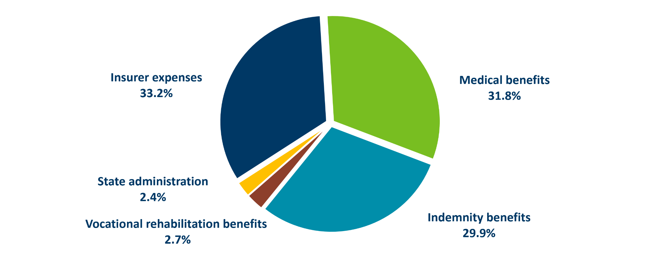
Insurer expenses were the largest component of total system cost in 2024, followed closely by medical benefits
Total benefit payments (including indemnity, medical and vocational rehabilitation components) accounted for 64.4% of total system cost in 2024.
Notes:
In 2024, insurer expenses made up the largest portion of system cost at about 33%, followed by medical benefits at 32% and indemnity benefits at 30%. Smaller components included vocational rehabilitation benefits and state administration. Total benefit payments (with voc rehab included) made up about 64% of the system cost.
From 2023 to 2024:
The share of medical benefits went down from 33% to 32%. (this is likely due to the effects of medical fee schedules, including the statutory cuts in hospital outpatient fee schedule that took effect in Oct. 2023 as well as stabilization of prices for nonhospital professional services).
The share of indemnity benefits went up from 29% to 30%.
The share of insurer expenses, vocational rehabilitation benefits, and state administration remained roughly similar to 2023.
Background:
Indemnity and medical benefits include those reimbursed through DLI programs (including supplementary and second-injury benefits) and those paid through insurance guaranty entities (the Minnesota Insurance Guaranty Association and the Self-Insurers' Security Fund). Indemnity benefits include those claimant attorney costs that are paid out of indemnity benefits. Indemnity benefits here exclude vocational rehabilitation.
Insurer expenses include underwriting, brokerage, claim adjustment, litigation, general operations, taxes, fees and profit. Litigation costs include defense attorney costs plus those claimant attorney costs that do not come out of indemnity benefits but are paid by the insurer. Excludes assessments on insurers and self-insurers because the benefits and state administration financed with those assessments are counted elsewhere in the figure.
State administration includes costs of workers' compensation functions in DLI, the Office of Administrative Hearings, the Workers' Compensation Court of Appeals and the Department of Commerce, as well as the state share of the cost of Minnesota's OSHA program. Excludes costs of benefit payments reimbursed by the Special Compensation Fund (such as supplementary and second-injury benefits).

Slide 11
Indemnity claims and benefits in detail
Notes:
This section will present additional detail about the indemnity claim and benefit information provided in the earlier section.

Slide 12
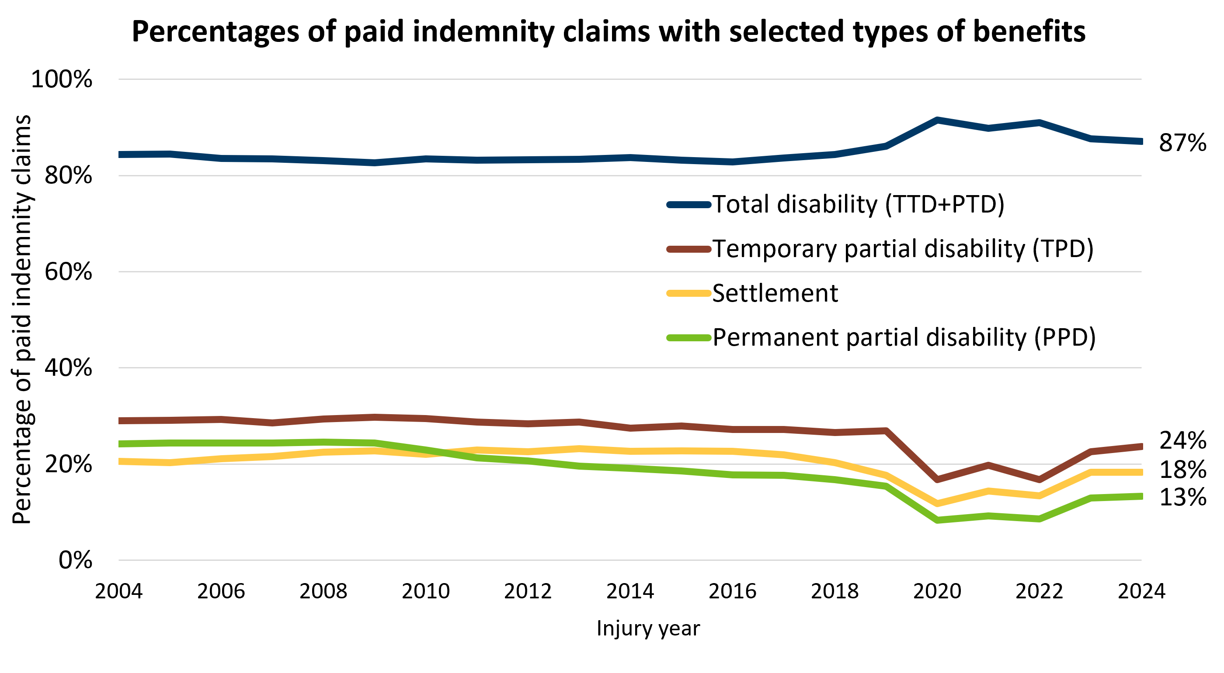
Distribution of indemnity benefit types returned to pre-pandemic levels in 2023-2024
In 2024:
  87% of indemnity claims received total disability benefits;
  24% received TPD benefits;
  18% received settlement benefits;
  13% received PPD benefits.
  All were similar to 2023 values.
Pandemic impact:
  All benefit types fluctuated in 2020-2022 but returned closer to long-term pre-pandemic patterns in 2023-2024.
  Majority of Covid-19 claims received only total disability benefits.
Source: Developed statistics from DLI Campus database.
Notes:
This slide shows how the distribution of different indemnity benefit types have changed over time. (An indemnity claim may have more than one type of benefit paid; therefore, the sum of the percentages for the different benefit types is greater than 100%.)
In 2024, most indemnity claims - about 87% - involved total disability benefits, with smaller shares receiving TPD, settlements, or PPD benefits. Prior to 2020, trends were relatively stable for most benefit types.
During the pandemic years, all benefit types fluctuated, especially total disability benefits, which saw a noticeable spike. COVID‑19 claims received almost entirely total disability benefits, which explains the temporary increase in total disability benefits in 2020-2022 while all other benefit types decreased. By 2023 and 2024, these distributions mostly returned to their long‑term pre‑pandemic levels.

Slide 13
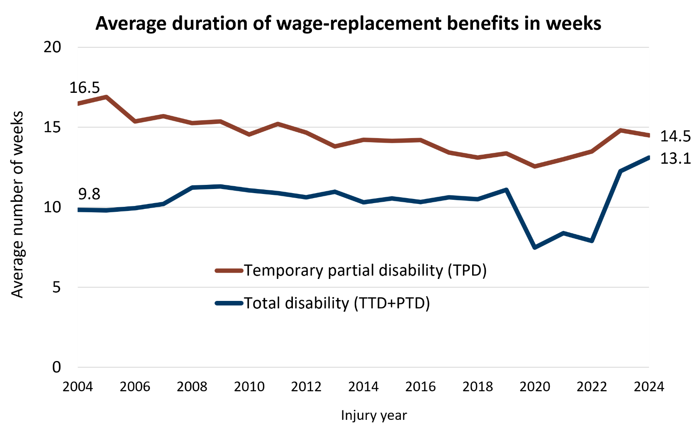
The average amount of time an injured worker received total disability and TPD benefits increased after the pandemic
In 2024:
Total disability benefits: Estimated duration averaged 13.1 weeks – up from 12.2 weeks in 2023.
TPD benefits: Estimated duration averaged 14.5 weeks – slightly below 14.8 weeks in 2023.
Pandemic period: Many indemnity claims were short-duration COVID-19 claims.
Post-pandemic: Longer disability durations were driven by more complex claims, medical care backlogs, and a tight labor market with newly hired, less experienced workers.
Source: Developed statistics from DLI Campus database.
Notes:
This slide shows the estimated average duration of total disability and temporary partial disability benefits.
In 2024, estimated total disability duration was about 13.1 weeks, up from 12.2 weeks in 2023. From 2004 to 2024, total disability duration increased by 33%. In 2024, TPD duration averaged 14.5 weeks, which was just slightly below the 2023 level. Over the last 20 years, TPD duration saw a 12% decrease.
The sharp dip seen around 2020-2022 reflects the large number of short‑duration COVID‑19 claims during the pandemic. As COVID-19 claims declined in 2023-2024, average durations rose again. Longer disability durations in the early post-pandemic period were also affected by more complex claims, rising comorbidities, medical care backlogs after the pandemic, and a tight labor market where many newly hired workers had less experience and were more prone to injury.
(WCRI Compscope Benchmarks report for MN, 2026 Edition show more of a stabilization in TD (TTD+TPD) duration for 2024 claims at one-year maturity, following increases of more than one week per year in the prior two years. However, for claims at 3-year maturity, TD duration was around 14 weeks – slightly below the median of 15 weeks.)

Slide 14
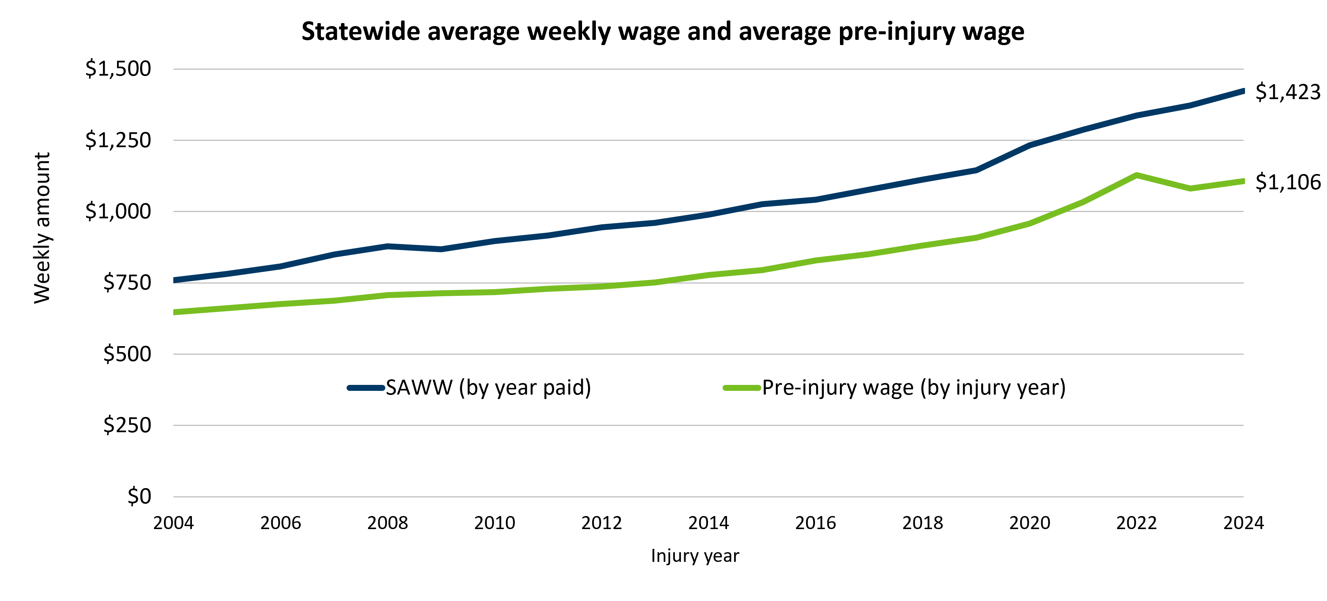
From 2004 to 2024, the statewide average weekly wage rose 87%, while the pre-injury wage rose 71%
Notes:
While the SAWW rose 87% during this period, the APIW rose 71%. The APIW is less than the SAWW because paid claims are more common in lower-wage jobs. The pre-injury wage of injured workers is the primary basis for weekly wage-replacement benefits. However, from 2020 to 2022, APIW growth (18%) outpaced SAWW growth (9%). The faster growth in the APIW was largely fueled by labor market changes and the increase in COVID-19 claims in the pandemic period. Many workers included in the COVID-19 presumption had higher wages compared with all other workers.
Trends in Average Weekly Benefits:
After adjusting for average wage growth, weekly total disability benefits were estimated to average $859 for workers with 2024 claims. These benefits decreased between 2004 and 2020 with annual fluctuations, but increased 6% between 2020 and 2024. This increase can be attributed to several factors, including higher wages of workers with COVID-19 claims during the pandemic and the statutory increases in the minimum and maximum TTD rates, which took effect in Oct. 2021 and 2024.
Wage-adjusted weekly TPD benefits were estimated to average $405 for workers with 2024 claims. These benefits declined between 2004 and 2015, but steadily increased from 2015 to 2024, with minor annual fluctuations.

Slide 15
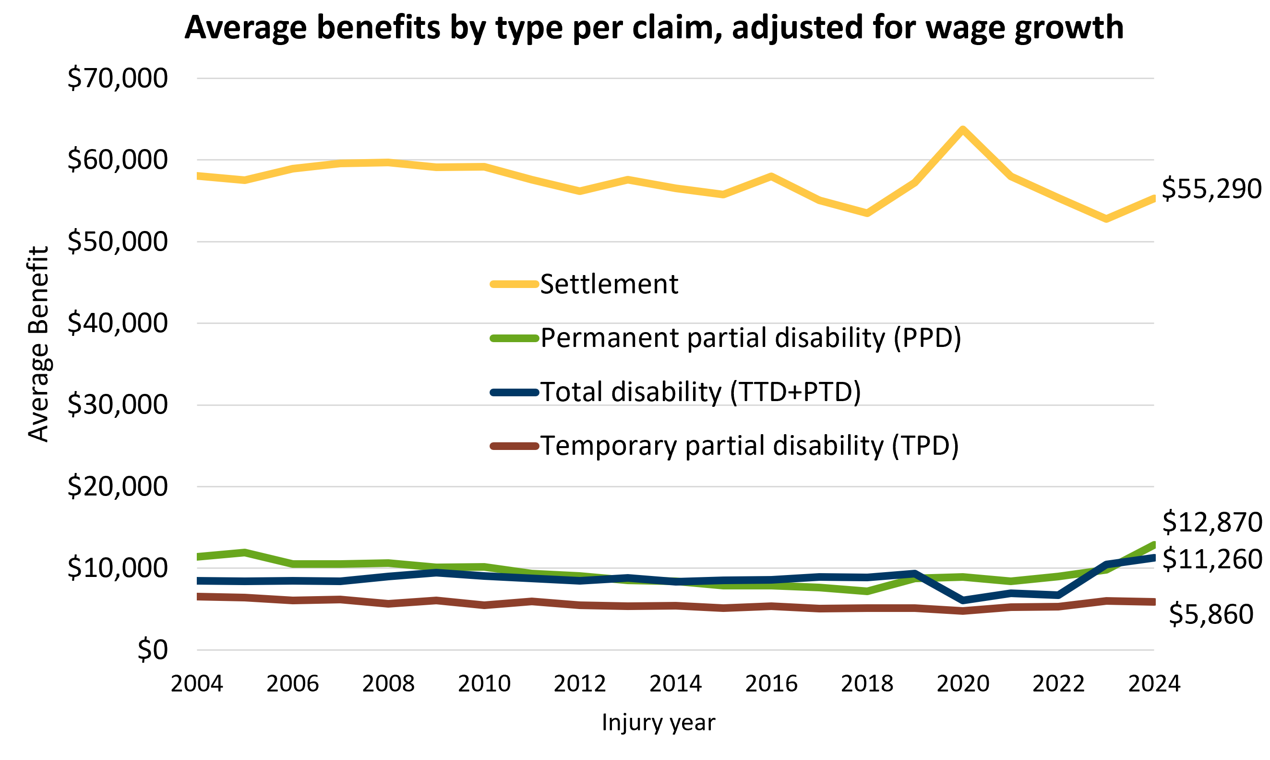
Average total disability benefits were most affected by COVID-19 in 2020-2022, but increased afterward
From 2004 to 2024:
  Wage-adjusted average total disability benefits increased 33%, matching the 33% increase in total disability duration;
  Average TPD benefits decreased 10%;
  Average PPD benefits increased 13%;
  Average settlement benefits decreased 5%.
Total disability benefits showed the strongest COVID‑19 impact in 2020–2022. Higher wages and benefit rates contributed to increase in post-pandemic period.
Source: Developed statistics from DLI Campus database.
Notes:
This slide shows average benefits by type, adjusted for wage growth. Average settlement benefits are consistently much higher than total disability, TPD, and PPD benefits.
Looking at the longer‑term changes from 2004 to 2024, total disability benefits increased 33%, matching the increase in total disability duration. TPD benefits declined about 10%, PPD benefits rose 13%, and settlement benefits fell slightly, by about 5%. Trends in total disability and TPD benefits are driven by the trends in average benefit duration and average weekly benefits.
Overall, total disability benefits showed the strongest pandemic‑related impact (as many COVID claims had lower benefits and durations), while the other benefit types stayed relatively stable. Decline in COVID-19 claims, higher wages and statutory changes to benefit rates contributed to increases in total disability benefits and PPD benefits in the post-pandemic period (see next slide).
Peak in settlement data in 2020: DLI analysis showed that there was a significant increase in both the number of claims with settlements and in average settlement payments per claim for police and public-sector employees for injury-year 2020. From 2019 to 2020, the number of claims with settlements in the police protection industry tripled. These claims also involved higher average settlement benefits per claim compared to other years.

Slide 16
Recent statutory changes increased TTD minimum/maximum weekly benefits and PPD benefit schedule
Statutory changes affecting temporary total disability (TTD) minimum and maximum weekly benefits:
Starting Oct. 1, 2021, the minimum weekly benefit changed from $130 to 20% of the maximum benefit.
  Current value (effective Oct. 1, 2026) is $318.82.
Starting Oct. 1, 2024, the maximum weekly benefit changed from 102% to 108% of the Statewide Average Weekly Wage (SAWW).
  Current maximum value (effective Oct. 1, 2026) is $1,594.08.
Statutory changes affecting permanent partial disability (PPD) benefit schedule:
In October 2023, the PPD benefit schedule was increased by different proportionate amounts for different impairment ratings, resulting in an estimated overall increase of 38%.
Another 20% uniform increase to the PPD benefit schedule took effect in October 2025.
Notes:
This slide shows the recent statutory updates to indemnity benefits.
On the left side are the updates to the TTD minimum and maximum weekly benefits. The minimum weekly benefit was raised in 2021 from $130 to 20% of the maximum benefit; the current value effective Oct. 1 is $318.82. Workers with weekly wages between $318.82 and $478.27 will receive the minimum benefit. Workers with wages less than the minimum receive 100% of their wage.
The maximum weekly benefit also increased in 2024 from 102% to 108% of the SAWW, bringing the current max value to $1,594. The maximum weekly benefit increased in 2024, bringing the current value to $1,594. The maximum weekly benefit is available to workers with weekly wages higher than $2,391.20.
Current SAWW (effective Oct. 1, 2026) is $1,476.
On the right side are the changes to PPD benefits. In October 2023, the PPD schedule was revised with different increases depending on the impairment rating, resulting in an overall increase of about 38%. The largest increases were for lower impairment ratings:
Ratings under 20.5% were increased by 45%;
Ratings from 20.5% to 30.4% were increased by 40%;
Ratings from 30.5% to 45.4% were increased by 30%;
Ratings from 45.5% to 50.4% were increased by 21%;
Ratings of 50.5% and higher were increased by 5%.
Then in October 2025, an additional 20% uniform increase took effect.

Slide 17
Vocational Rehabilitation
Notes:
This section provides information about vocational rehabilitation services in Minnesota’s workers’ compensation system.

Slide 18
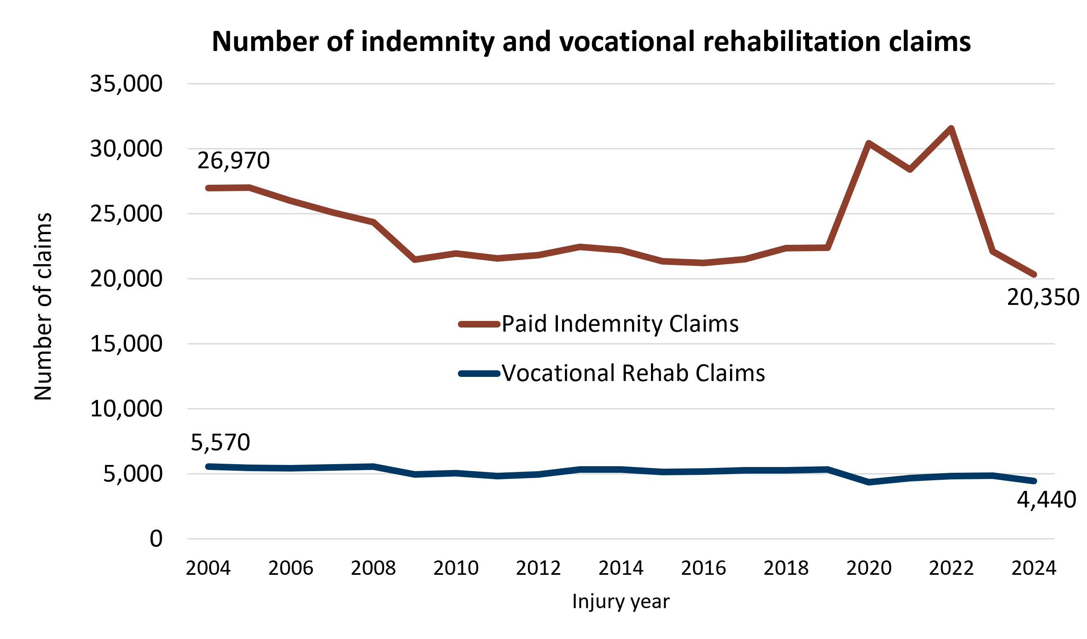
Number of workers entering vocational rehabilitation decreased in 2024 but share of injured workers receiving voc rehab remains stable
For 2024 injuries, 22% of all workers with indemnity benefits had voc rehab plans, similar to 2023.
Number of voc rehab claims decreased 9% from 2023 to 2024, while number of injured workers receiving benefits decreased 8% during this period.
Source: Developed statistics from DLI Campus database.
Notes:
Only a handful of workers with COVID-19 claims have received voc rehab benefits.

Slide 19
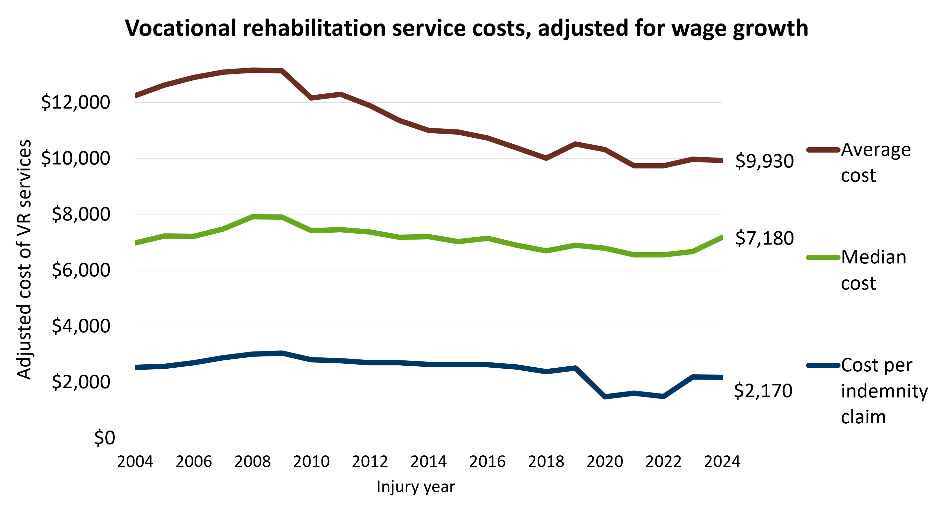
The adjusted average cost of $9,930 for 2024 was 24% below the adjusted average cost peak of $13,150 in 2008
The average cost had been steadily decreasing since that peak, although it has remained stable since 2021 with minor fluctuations.
The adjusted total cost of vocational rehabilitation services for injury-year 2024 is estimated at $44.1 million, a 9% decrease from 2023.
The adjusted median cost of $7,180 for 2024 was 8% higher than the 2023 adjusted median cost and 9% below the median peak of $7,910 in 2008.
Source: Developed statistics from DLI Campus database.

Slide 20
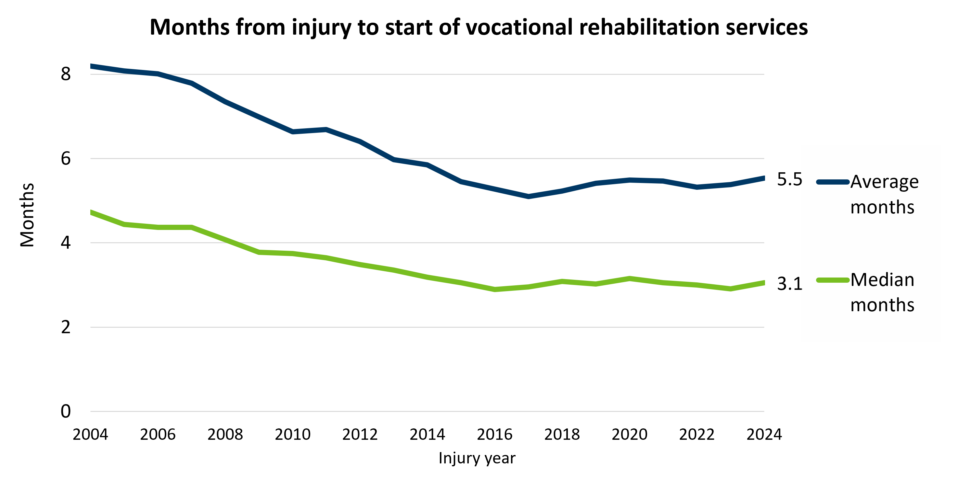
The time from injury to start of services has been steadily declining over the last 20 years with some fluctuations
Average months from injury to start of services decreased from 8 in months in 2004 to 5.5 months in 2024 (3.5 months).
Median months decreased from approximately 5 in 2004 to 3.1 in 2024 (2 months).
Source: Developed statistics from DLI Campus database.

Slide 21
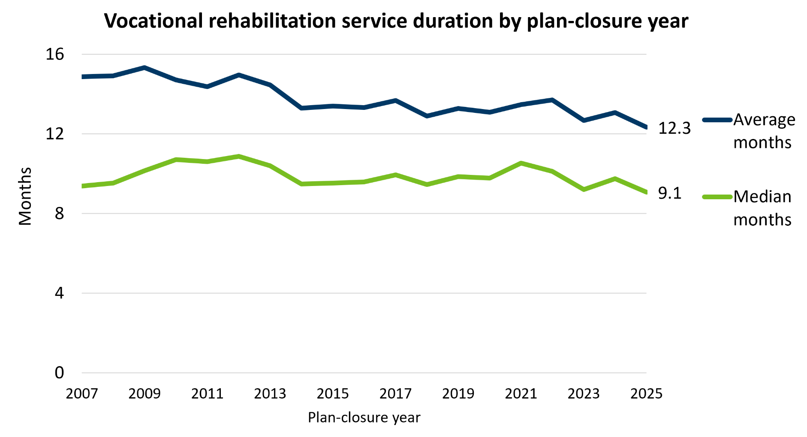
Average and median voc rehab service durations have remained stable for the last 10 years with some fluctuations
Average service duration decreased from about 15 months in 2009 to little under 12 months in 2025.
The estimated median service duration of 9.1 months for closure-year 2025 is the shortest median duration during the period included.
Source: Developed statistics from DLI Campus database.

Slide 22
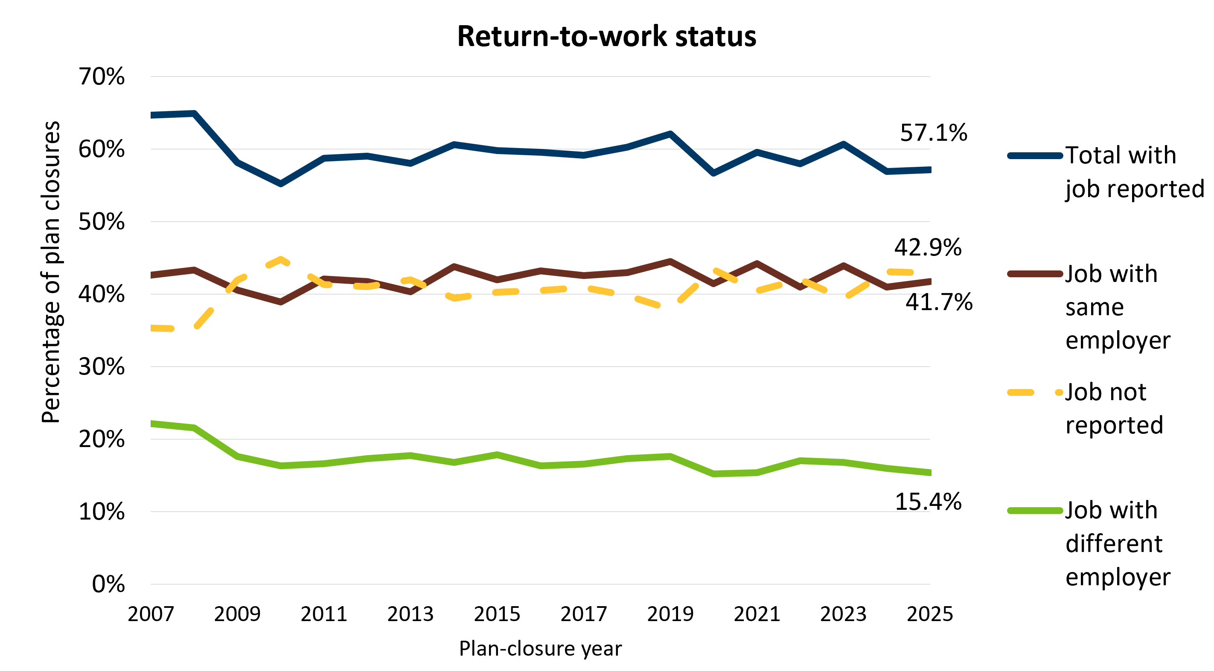
57% of voc rehab plans closing in 2025 showed participants back to work
The estimated percentage of vocational rehabilitation participants with a job at plan closure in 2025 was similar to 2024.
A return to work was reported for 98% of workers with completed plans and for 23% of workers whose plans closed for any other reason.
Source: Developed statistics from DLI Campus database.
Notes:
For plan closures in 2025, the median cost of vocational rehabilitation services for participants returning to work with their pre-injury employer ($5,383) was 57% of the vocational rehabilitation cost of workers going to a different employer ($9,434) and 64% of the cost for workers not returning to work at plan closure ($8,461).

Slide 23
Dispute Resolution
Notes:
This section presents statistics about dispute filings for all claims and for dispute-resolution activities at the MN Department of Labor and Industry.

Slide 24
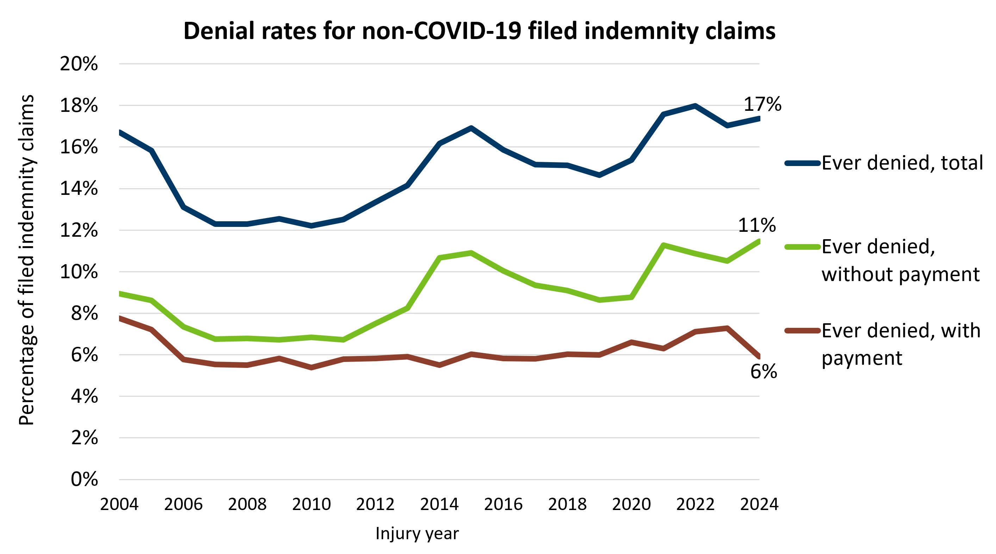
Denial rates for non-COVID claims have fluctuated in recent year but remain within historic range
The denial rate for non-COVID-19 claims was 17.4% in 2024, about half a percentage point higher than 2023.
Those denied without payment slightly increased from 2023 to 2024 while those denied with payment decreased by one percentage point during the same period.
Source: Developed statistics from DLI Campus database.
Notes:
Less emphasis on COVID from 2024 onward.

Slide 25
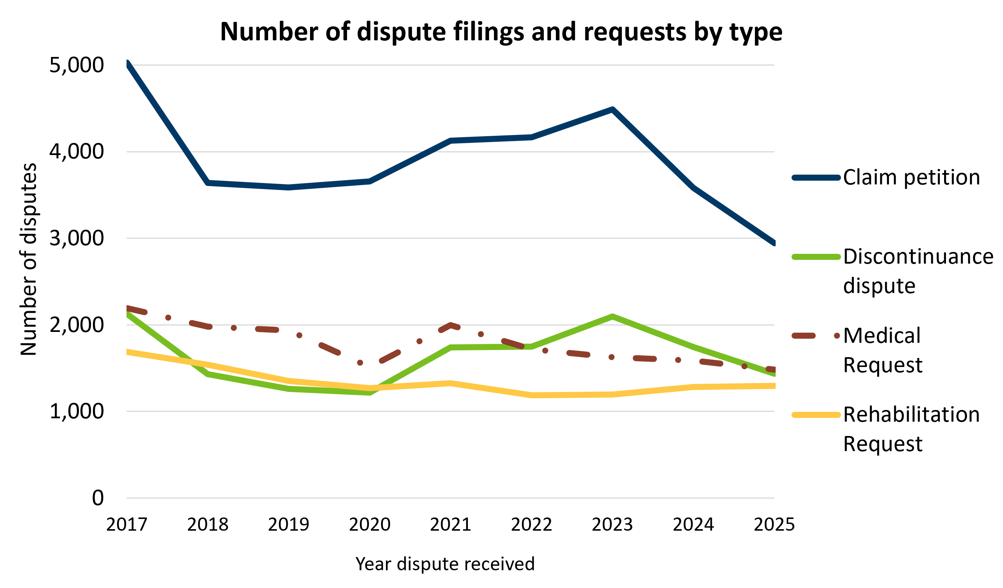
Dispute filings among the four major categories decreased 11% from 2019 to 2025
The number of claim petition filings in the DLI claims database increased 25% from 2019 to 2023 but has since decreased by 34%. The data from the latest year is preliminary.
Discontinuance disputes increased by 66% from 2019 to 2023 but have decreased by 32% since then.
The number of medical dispute requests has been steadily decreasing since 2017, except in 2021 when requests temporarily increased before resuming their decline in 2022. Since 2022, filings have decreased by 14%.
Source: Data from DLI Campus database.

Slide 26
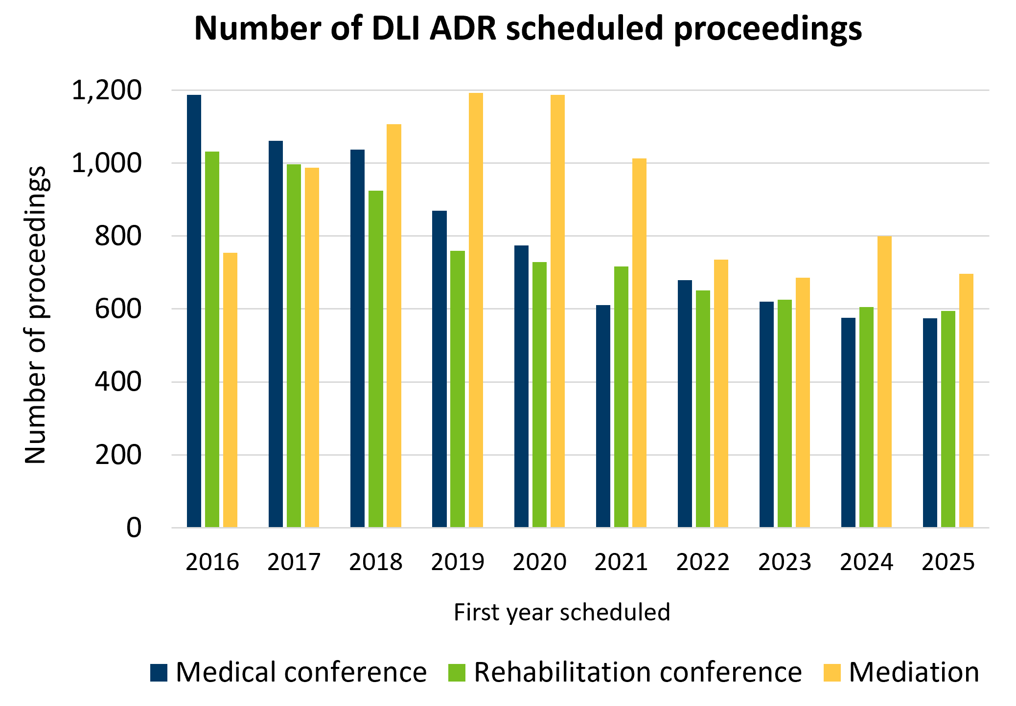
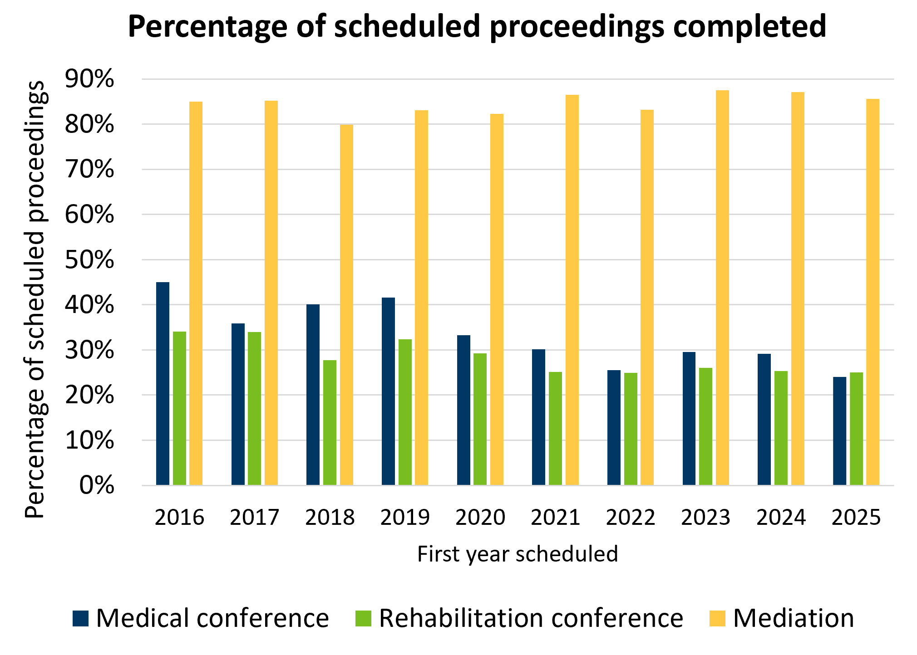
The number of mediations and conferences in recent years were stable with minor fluctuations
Source: Data from DLI Campus database.
Notes:
The figure on the right shows that most scheduled medical and rehab conferences are not held, while more than 80% of mediations are held. Some of the disputes originally scheduled as conferences became mediations.

Slide 27
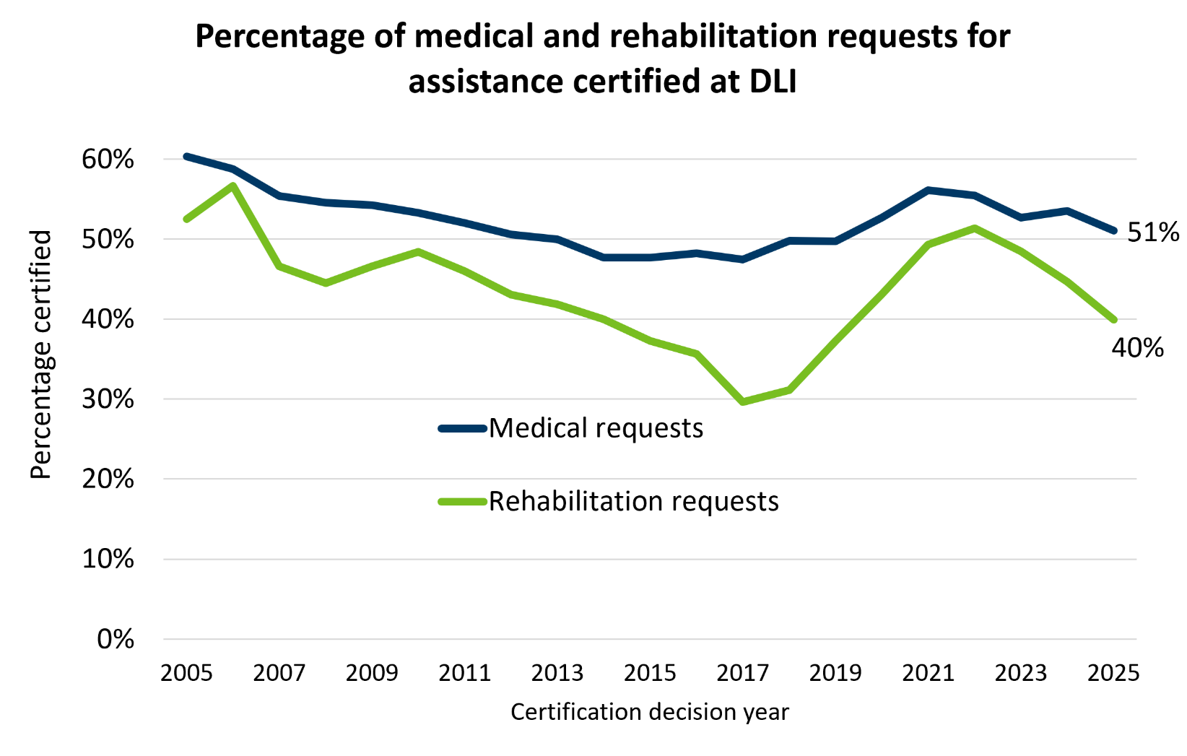
Percentage of medical and rehabilitation requests for assistance certified slightly decreased in the last 2 years
The percentage of medical and rehabilitation requests that are certified as disputes followed a downward trajectory prior to 2017 but has fluctuated since.
  Percentage of medical requests for assistance increased from 47% in 2017 to 54% in 2024 but decreased to 51% in 2025.
  Percentage of rehabilitation requests for assistance increased from 30% in 2017 to 45% in 2024 but decreased to 40% in 2025.
  68% of medical requests not certified were resolved by ADR in 2025.
Source: Data from DLI Campus database.
Notes:
The percentage of noncertified rehabilitation requests resolved by intervention during the certification process dipped from 60% in 2018 to 55% in 2020. Since then, it has steadily increased, reaching 69% in 2025.

Slide 28
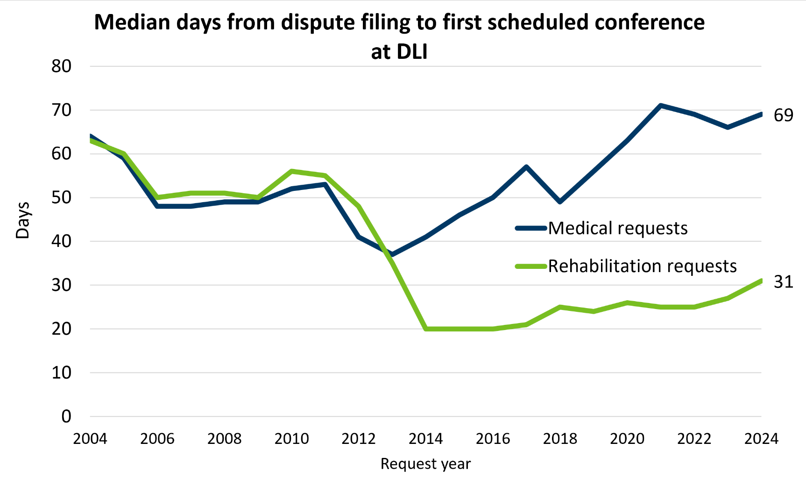
Increased period from medical request to scheduled conference
The time from medical and rehabilitation requests to the first scheduled conference at DLI have diverged in recent years.
2013 law change required rehab request conferences to take place within 21 days of the request. This impacted the timing for both medical and rehab conferences.
Source: Data from DLI Campus database.
Notes:
For medical requests, the median time to the first scheduled conference dropped from 64 days in 2004 to 37 days in 2013, and then increased to 69 days in 2024.
For rehabilitation requests, the median time to the first scheduled conference dropped from 63 days in 2004 to 20 days in 2014, and has since increased to 31 days in 2024

Slide 29
Takeaways
Overall, system cost and claim rates continued their long-term downward trend.
COVID-19 impact on system statistics diminished significantly by 2024.
Statutory updates to TTD rates and PPD benefit schedule contributed to increases in those benefits in recent years.

Slide 30
Thank you!
We welcome your questions!
Hared Mah hared.mah@state.mn.us

